Slide 1

Blazor in .net 8

Slide 2
Agenda
Blazor Web App
Introduction
Render Mode
LifeCycle
PreRender
New Features
Route to named elements
Quick Grid
Modifiers Data Binding
Webcil packaging
Add CascadingValue
Inject keyed services
Form
Sections
Virtualize empty content
Dialog Events
Error Page
Render outside asp .net core

Slide 3
Q1:difference between wasm and auto render
A: auto render can Interactive before wasm load complete, wasm can only Interactive after load complete
Q2:difference between prerender and SSR Render
Q3:entrance of render
A: render as a DelegateRequest invoked in endpoint
Q4:Blazor web using sensario

Slide 4
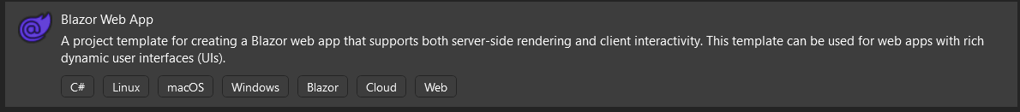
Blazor Web App
Introduction
Blazor Web is a full-stack web UI framework that render content at either the component or page level with:
Static server rendering to generate static HTML.
Interactive Server rendering.
Interactive WebAssembly rendering.
Interactive Auto (automatic) rendering.
https://learn.microsoft.com/en-us/aspnet/core/release-notes/aspnetcore-8.0?view=aspnetcore-8.0#full-stack-web-ui

Slide 5
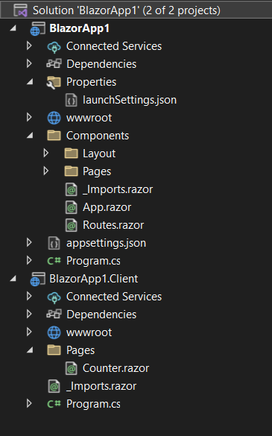
Blazor Web App
Introduction
The components in the server is in the solution's project Components/Pages folder.
The components in the client is in the solution's project Pages folder with a name that ends in .Client.
// Add services to the container.
// Add services to support rendering Interactive Server and WebAssembly components.
builder.Services.AddRazorComponents()
.AddInteractiveServerComponents()
.AddInteractiveWebAssemblyComponents();
//......
app.MapRazorComponents<App>()
.AddInteractiveServerRenderMode()
.AddInteractiveWebAssemblyRenderMode()
.AddAdditionalAssemblies(typeof(Counter).Assembly);

Slide 6
Blazor Web App
Render Mode
Name | Description | Render location | Interactive
Static | Static server rendering | Server | ❌
Interactive Server | Interactive server rendering using Blazor Server | Server | ✔️
Interactive WebAssembly | Interactive client rendering using Blazor WebAssembly | Client | ✔️
Interactive Auto | Interactive client rendering using Blazor Server initially and then WebAssembly on subsequent visits after the Blazor bundle is downloaded | Server, then client | ✔️
https://learn.microsoft.com/en-us/aspnet/core/blazor/components/render-modes?view=aspnetcore-8.0#render-modes

Slide 7
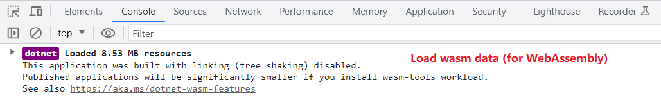
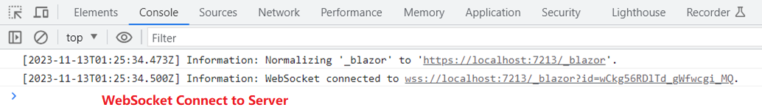
Blazor Web App
Render Mode
WebAssembly
Server

Slide 8
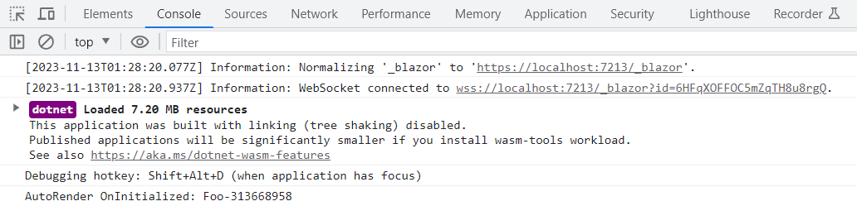
Blazor Web App
Render Mode
Auto

Slide 9
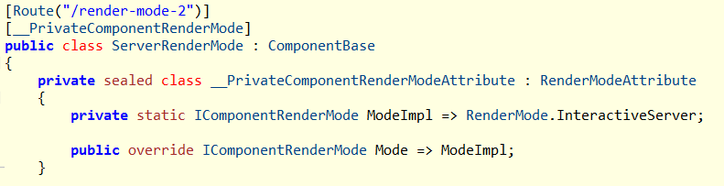
Blazor Web App
Render Mode
Component will generate a private __PrivateComponentRenderModeAttribute which distingulish the RenderMode:
@page "/render-mode-2"
@rendermode RenderMode.InteractiveServer
<h3>Server Render Mode</h3>

Slide 10
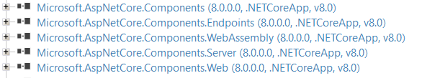
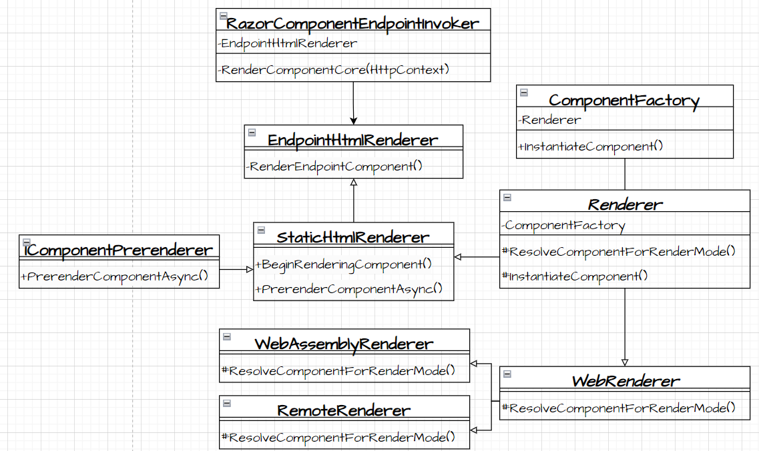
Blazor Web App
Render Mode
Render Componment:
RazorComponentEndpointInvoker.cs

Slide 11
Blazor Web App
Render Mode
EndpointHtmlRenderer _renderer;
RenderComponentCore(HttpContext)
{
_renderer.InitializeStreamingRenderingFraming()
{
httpContext.Response.Headers.Add("ssr-framing",new Guid());
}
...
htmlContent = _renderer.RenderEndpointComponent(HttpContext,...)
if (!isErrorHandler)
{
componentStateHtmlContent = await _renderer.PrerenderPersistedStateAsync(context);
componentStateHtmlContent.WriteTo(bufferWriter, HtmlEncoder.Default);
}
await bufferWriter.FlushAsync();
}

Slide 12
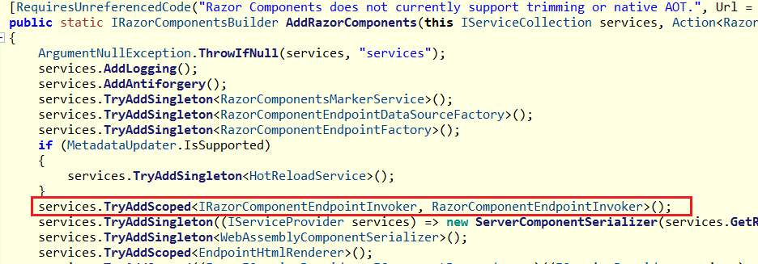
Blazor Web App
Render Mode
RazorComponentEndpointInvoker registed when AddRazorComponents

Slide 13
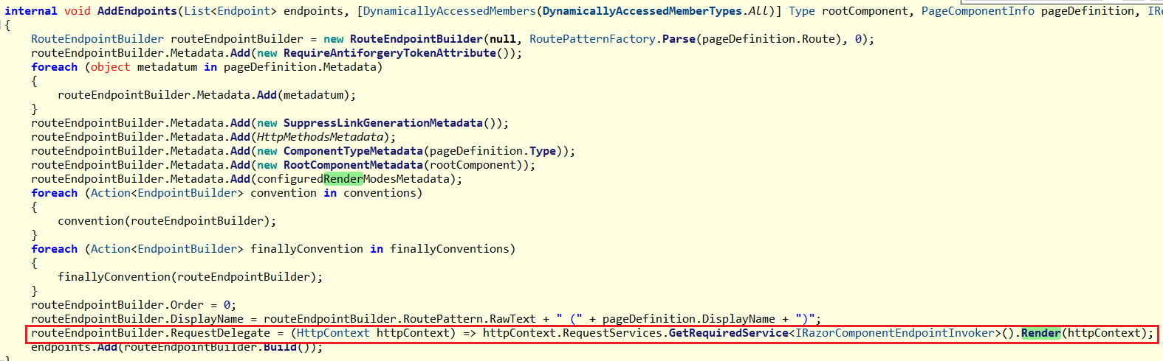
Blazor Web App
Render Mode
RazorComponentEndpointInvoker.Render added to Endpoint.RequestDelegate when AddEndpoint.
Which means render happen when access the end point

Slide 14
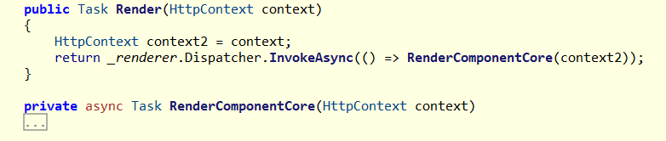
Blazor Web App
Render Mode
Invoke RazorComponentEndpointInvoker.RenderComponentCore() at RazorComponentEndpointInvoker. Render()

Slide 15
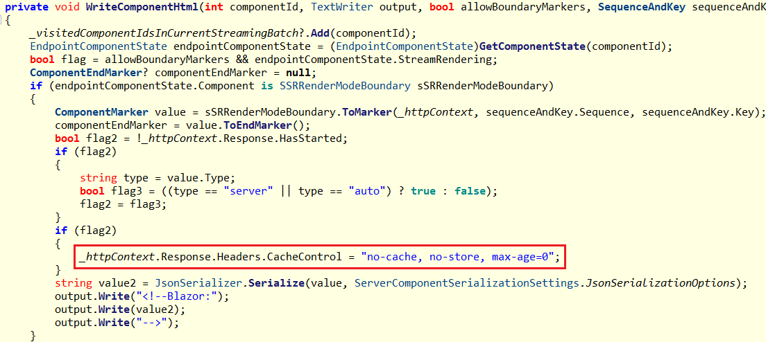
Blazor Web App
Render Mode
EndpointHtmlRenderer.WriteComponentHtml
When is SSRRenderModeBoundary will go into there:

Slide 16
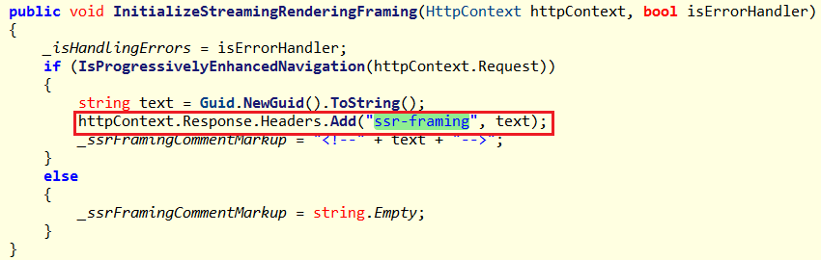
Blazor Web App
Render Mode
EndpointHtmlRenderer.InitializeStreamingRenderingFraming

Slide 17
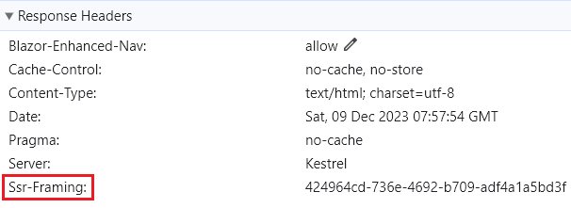
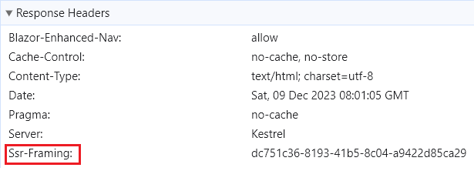
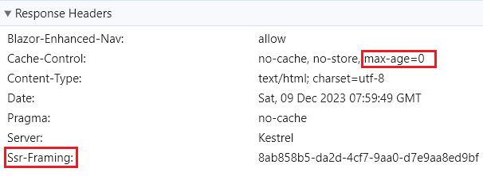
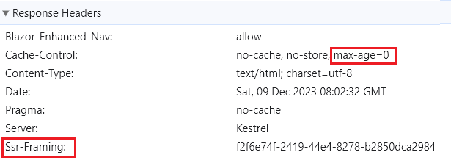
Blazor Web App
Render Mode
Start with static-mode
Start with wasm-mode
Start with server-mode
Start with auto-mode

Slide 18
Blazor Web App
Life Cycle
ASP.NET Core Razor component lifecycle
.net 6.0/8.0 Blazor Server/WebAssembly App | .net 8.0 Blazor Web App Server/WebAssembly/Auto Mode | .net 8.0 Blazor Web App Static Mode
SetParametersAsync - Begin OnInitialized OnInitializedAsync OnParametersSet OnParametersSetAsync SetParametersAsync - End | SetParametersAsync - Begin OnInitialized OnInitializedAsync OnParametersSet OnParametersSetAsync SetParametersAsync – End SetParametersAsync - Begin OnInitialized OnInitializedAsync OnParametersSet OnParametersSetAsync SetParametersAsync – End | SetParametersAsync - Begin OnInitialized OnInitializedAsync OnParametersSet OnParametersSetAsync SetParametersAsync - End
SSR (Server Side Rendering)

Slide 19
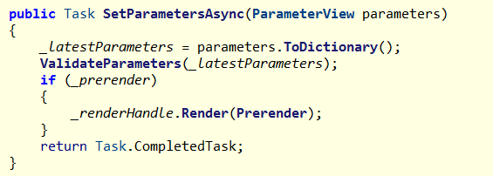
Blazor Web App
PreRender
Blazor apps that prerender their content on the server, so components call OnInitialized twice
Prerender switch on by default
Prerender at SSRRenderModeBoundary.cs

Slide 20
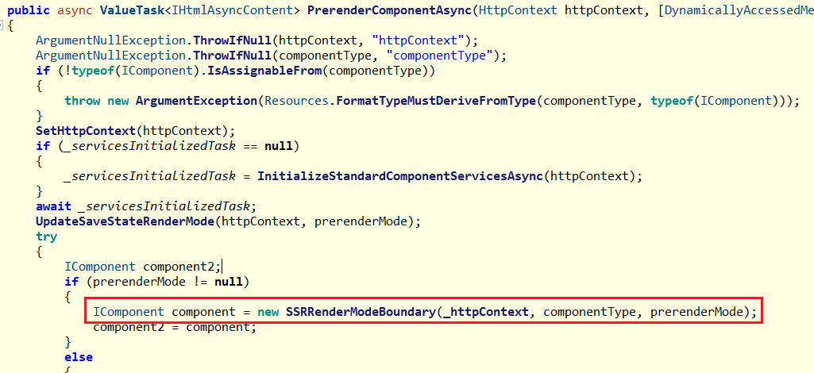
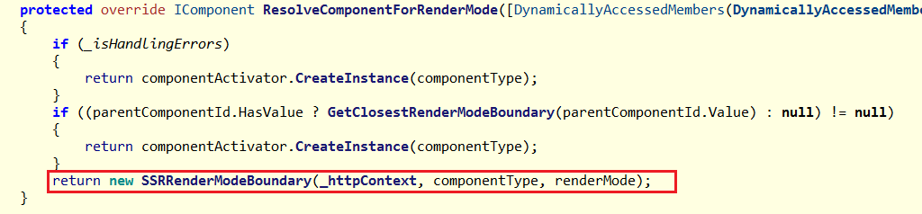
Blazor Web App
PreRender
SSRRenderModeBoundary is the start of a subtree with a rendermode, so introduce a new rendermode boundary here
SSRRenderModeBoundary created in EndpointHtmlRenderer. ResolveComponentForRenderMode and EndpointHtmlRenderer .PrerenderComponentAsync
EndpointHtmlRenderer.PrerenderComponentAsync used in RazorComponentResultExecutor. RenderComponentToResponse

Slide 21
Blazor Web App
PreRender
RenderComponentToResponse(HttpContext httpContext,...)
{
var endpointHtmlRenderer = httpContext.RequestServices.GetRequiredService<EndpointHtmlRenderer>();
return endpointHtmlRenderer.Dispatcher.InvokeAsync()
{
endpointHtmlRenderer.InitializeStreamingRenderingFraming(httpContext, isErrorHandler)
{
httpContext.Response.Headers.Add("ssr-framing",new Guid());
}
var htmlContent = endpointHtmlRenderer.PrerenderComponentAsync(...);
htmlContent.WriteTo(bufferWriter, HtmlEncoder.Default);
...
await bufferWriter.FlushAsync();
}
}

Slide 22
Blazor Web App
PreRender
Can disable prerender as follow:
public static class CustomerRenderMode
{
public static IComponentRenderMode InteractiveServerWithoutPrerender { get; }
= new InteractiveServerRenderMode(prerender: false);
public static IComponentRenderMode InteractiveAutoWithoutPrerender { get; }
= new InteractiveAutoRenderMode(prerender: false);
public static IComponentRenderMode InteractiveWebAssemblyWithoutPrerender { get; }
= new InteractiveWebAssemblyRenderMode(prerender: false);
}
PrerenderedServer.razor
@page "/prerendered-counter-server"
@rendermode CustomerRenderMode.InteractiveWebAssemblyWithoutPrerender

Slide 23
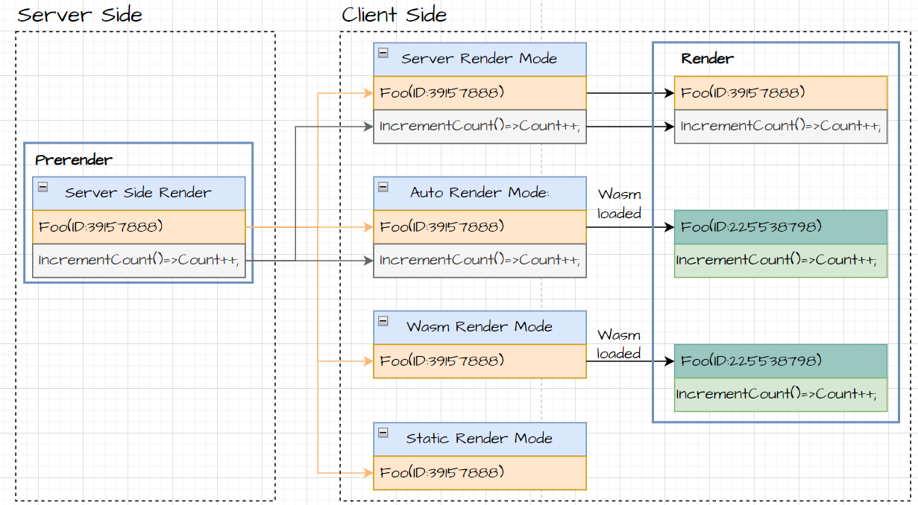
Blazor Web App
PreRender
PreRender enabled and rendering at server side

Slide 24
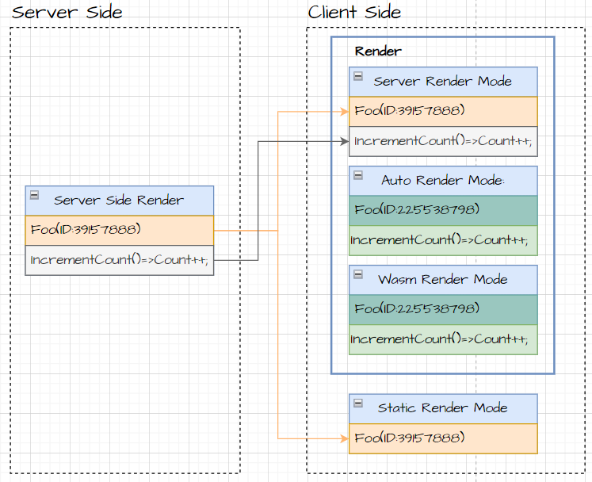
Blazor Web App
PreRender
PreRender Disabled

Slide 25
New Features
Feature | Detail | Application Support
 |  | Web | WebAssembly | Server(7.0)
.net 7.0
Route to named elements | Navigation.NavigateTo("/counter#targetElement"); | ✔️ | ✔️ | ✔️
Quick Grid | Blazor QuickGrid component | ✔️ | ✔️ | ✔️
Data Binding | New modifiers: @bind:get/set/after | ✔️ | ✔️ | ✔️
.net 8.0
Webcil packaging | Published with .wasm instead of .dll file | ✔️ | ✔️ | ❌
Add Cascading Value | Root-level cascading values | ✔️ | ✔️ | ❌
Inject keyed services | Inject keyed services into components | ✔️ | ✔️ | ❌
Form | AntiforgeryToken | ✔️ | ✔️ | ❌
Sections | Sections support | ✔️ | ✔️ | ❌
Virtualize empty content | Virtualize with empty content | ✔️ | ✔️ | ❌
Dialog Events | Support for dialog cancel and close events | ✔️ | ✔️ | ❌
Error Page | Default errorpage: /Pages/Error.razor | ✔️ | ❌ | ❌
Render outside asp .net core | Render Razor components outside of ASP.NET Core | - | - | -
https://learn.microsoft.com/en-us/aspnet/core/release-notes/aspnetcore-8.0?view=aspnetcore-8.0#blazor

Slide 26
New Features
Route to named elements
Navigate to a named element using the following approaches with a hashed (#) reference to the element.
Navigation.NavigateTo("/counter#targetElement");
Will Navigate to Element: <h2 id="targetElement"> in /counter page
<div class="border border-info rounded bg-info" style="height:500px"></div>
<h2 id="targetElement">Target H2 heading</h2> <p>Content!</p>
Quick Grid
QuickGrid is built to be a simple and convenient way to display your data, while still providing powerful features, such as sorting, filtering, paging, and virtualization.
<QuickGrid Items="@people">
<PropertyColumn Property="@(p => p.PersonId)" Sortable="true" />
<PropertyColumn Property="@(p => p.Name)" Sortable="true" />
<PropertyColumn Property="@(p => p.PromotionDate)" Format="yyyy-MM-dd" Sortable="true" />
</QuickGrid>

Slide 27
New Features
Modifiers Data binding
<input @bind="bindValue" />
<input @bind="bindValue" @bind:after="After" />
<input @bind="inputValue" @bind:event="oninput" />
<input @bind:event="oninput" @bind:get="twowayValue" @bind:set="OnInputTwoway"
@code {
private string? bindValue;
private string? inputValue;
private string? twowayValue;
private void OnInputTwoway(string value)
{
var newValue = value ?? string.Empty;
twowayValue = newValue.Length > 4 ? "Long!" : newValue;
}
private void After()
{
bindAfterValue = "Bind After";
}
}
After binding: @bind:after
Two-way binding: @bind:get and @bind:set

Slide 28
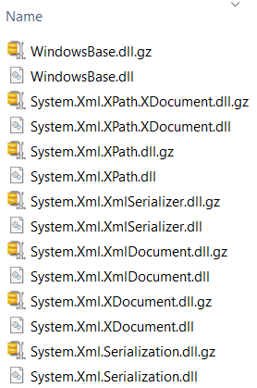
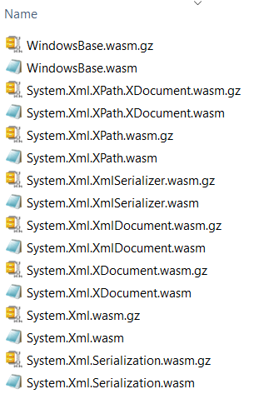
New Features
Webcil packaging
Webcil files use a standard WebAssembly wrapper, where the assemblies are deployed as WebAssembly files that use the standard .wasm file extension instead of .dll file.
For Blazor WebAssembly, output at {Project}.\bin\\{Debug or Release }\net8.0\wwwroot\_framework
For Blazor Web App, output at {Project}.Client\bin\{Debug or Release }\net8.0\wwwroot\_framework
https://github.com/dotnet/runtime/blob/main/docs/design/mono/webcil.md
.net 6.0
.net 8.0

Slide 29
New Features
Add CascadingValue
Root-level cascading values can be registered for the entire component hierarchy.
Named cascading values and subscriptions for update notifications are supported.
AddCascadingValue default lifecycle is Scoped
builder.Services.AddCascadingValue(provider => new Foo { Name = "Cascading Foo" });
builder.Services.AddCascadingValue("Alpha", sp => new Foo { Name = "Cascading Alpha Foo" });
@code {
[CascadingParameter]
public Foo? Foo { get; set; }
[CascadingParameter(Name = "Alpha")]
public Foo? AlphaFoo { get; set; }
}

Slide 30
New Features
Inject keyed services
Blazor now supports injecting keyed services using the [Inject] attribute.
builder.Services.AddKeyedSingleton<WeatherForecastService>("forecast-service");
[Inject(Key = "forecast-service")]
public WeatherForecastService ForecastService { get; set; }
Form
AntiforgeryToken component renders an antiforgery token
<form method="post" @onsubmit="Submit" @formname="starship-plain-form">
<AntiforgeryToken />
<InputText @bind-Value="Model!.Id" />
<button class="btn btn-primary" type="submit">Submit</button>
</form>

Slide 31
New Features
Section
Blazor supports sections to control the content in a Razor component from a child Razor component
Parent page
Child.razor
@page "/section"
@rendermode RenderMode.InteractiveServer
<h3>Section example</h3>
<SectionOutlet SectionName="child-content-a" />
<SectionOutlet SectionName="child-content-li1" />
<SectionOutlet SectionName="child-content-li2" />
<Child>
Content of the child component
</Child>
<button class="btn btn-primary">
Trigger a Parent component method
</button>
<SectionContent SectionName="child-content-p">
<p>Paragram:</p>
</SectionContent>
<SectionContent SectionName="child-content-li1">
<li>Section1 </li>
</SectionContent>
<SectionContent SectionName="child-content-li2">
<li>Section2</li>
</SectionContent>

Slide 32
New Features
Virtualize with empty content
Use the EmptyContent parameter to supply content when the component has loaded and either Items is empty or ItemsProviderResult<T>.TotalItemCount is zero.
Dialog
Blazor now supports the cancel and close events on the dialog HTML element.
OnClose is called when the my-dialog dialog is closed with the Close button.
Both OnCancel and OnClose is called when the dialog is canceled with the Esc key.

Slide 33
New Features
Error Page
Blazor Web Apps can define a custom error page for use with the ASP.NET Core exception handling middleware.
Default error page (Components/Pages/Error.razor) with similar content to the one used in MVC and Razor Pages apps.
Render components outside of ASP.NET Core
Use HtmlRenderer to render the component as static html by calling RenderComponentAsync.
await using var htmlRenderer = new HtmlRenderer(serviceProvider, loggerFactory);
var html = await htmlRenderer.Dispatcher.InvokeAsync(async () =>
{
var dictionary = new Dictionary<string, object?>
{
{ "Message", "Hello from the Render Message component!" }
};
var parameters = ParameterView.FromDictionary(dictionary);
var output = await htmlRenderer.RenderComponentAsync<RenderMessage>(parameters);
return output.ToHtmlString();
});

